Slide 1
Anatomy of the Galaxy

Slide 2
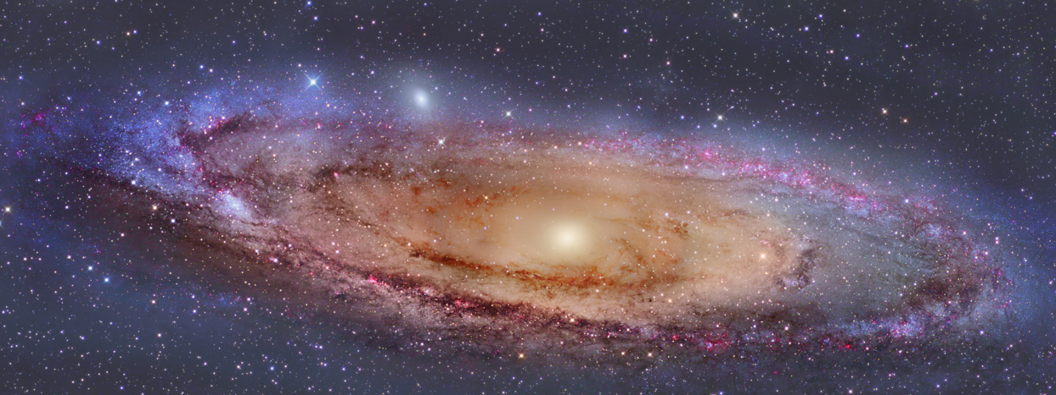
nucleus
OB associations – spiral arms
dust lanes
star forming regions

Slide 3
Main Parts of the Galaxy
Nucleus
Disk – open clusters
Spiral arms
OB associations
Star forming regions
Hal0
High Velocity Stars
Globular Clusters

Slide 4
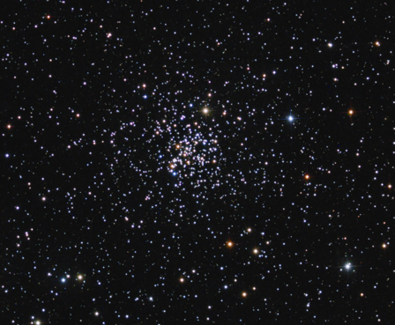
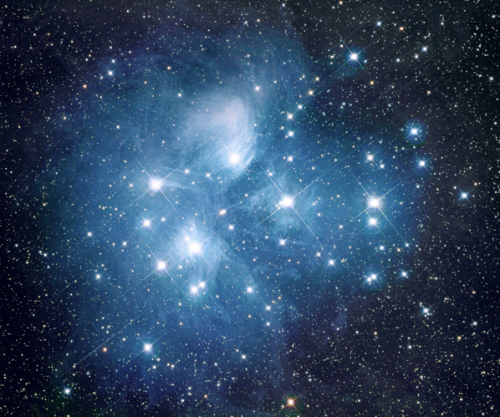
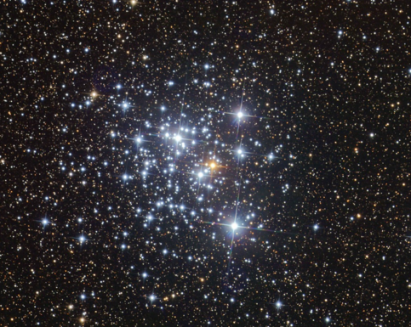
Open Clusters
M 67
M 45 - Pleiades
M 44 – Praesepe or Beehive

Slide 5
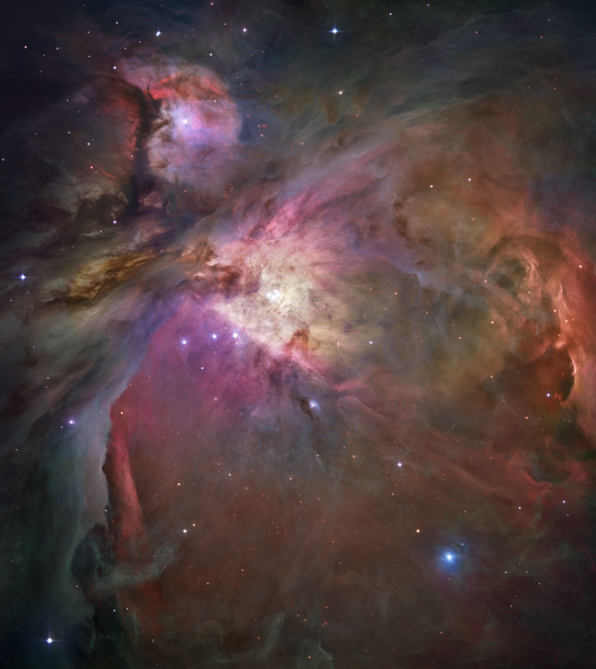
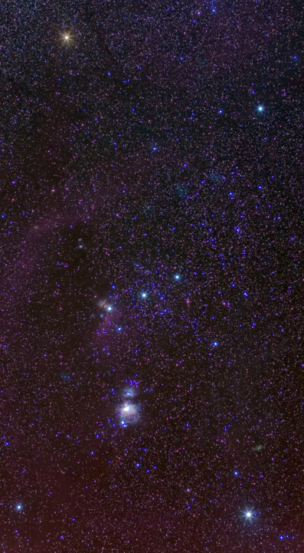
Star Forming Regions
M42 – Great Nebula in Orion

Slide 6
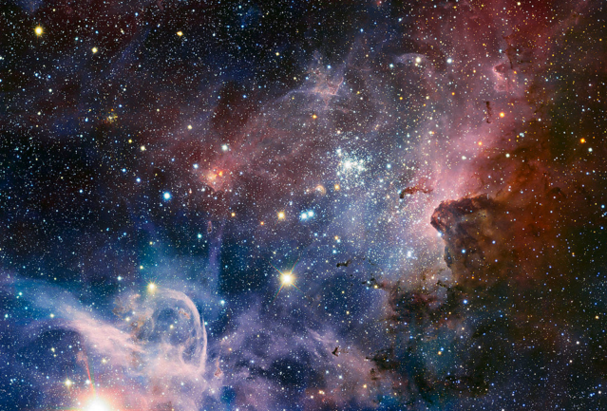
OB - Associations
Carina OB1

Slide 7
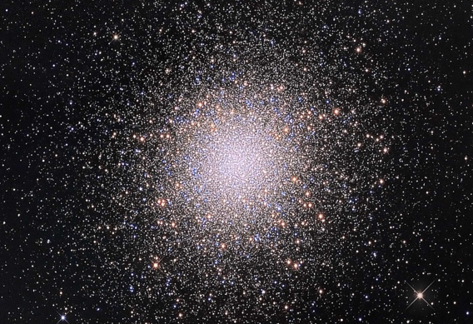
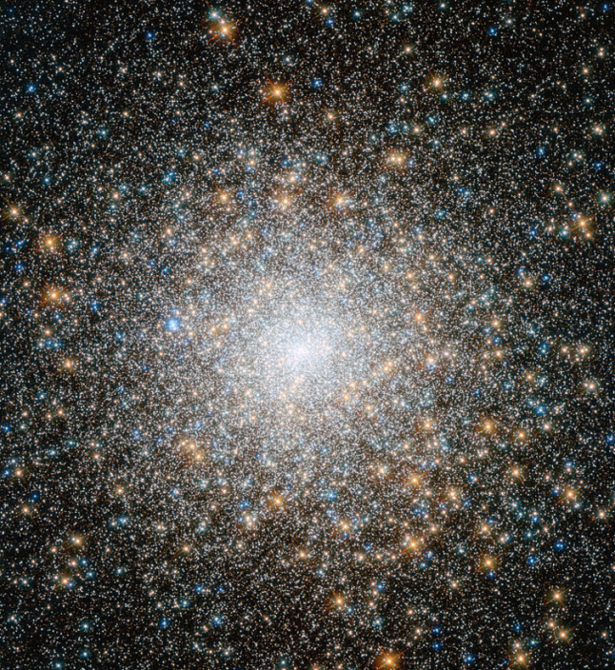
Globular Clusters
M15
M13

